Slide 1
Homework 6
Fuzzy C-Means
Zhicong Sun
Computer Science and Engineering
12032471@mail.sustech.edu.cn
2020.10.29

Slide 2

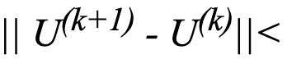
Exercise 4-1
The effects of m by the Fuzzy C-Means
Initialization:
randomly
Init
Use
to compute the initial centers
Test data set:
Five clusters
Location of centers:
(-1.15, -1.15), (-1.15, 1.15),
(0, 0), (1.15, -1.15), (1.15, 1.15)
Cluster variance
0.4, 0.4, 0.4, 0.4, 0.4
End condition:
error, error =0.1

Slide 3
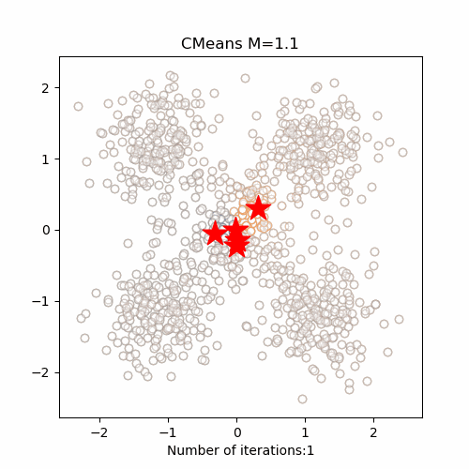
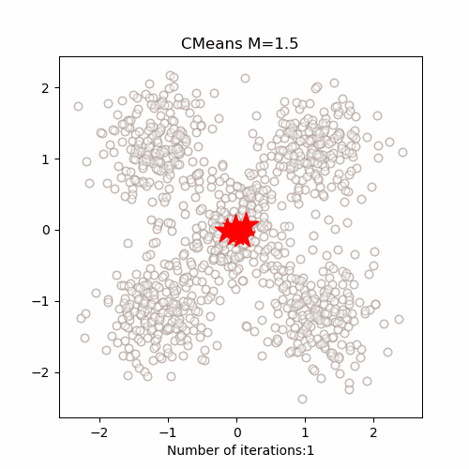
Exercise 4-1
The effects of m by the Fuzzy C-Means
M = 1.1
M = 1.5
Iterate 9 times
Iterate 11 times

Slide 4
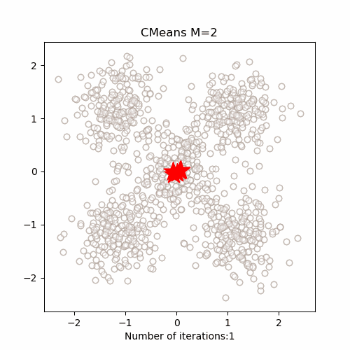
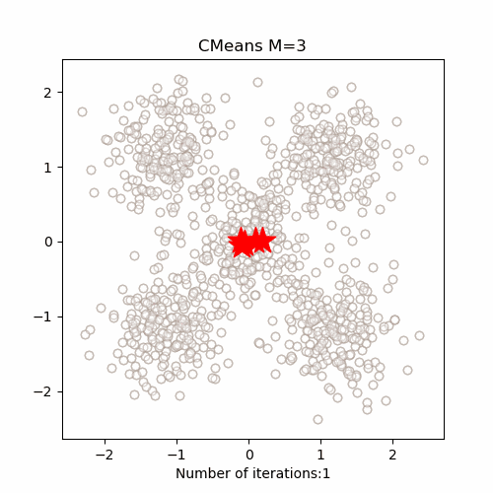
Exercise 4-1
The effects of m by the Fuzzy C-Means
M = 2
M = 3
Iterate 15 times
Iterate 22 times

Slide 5
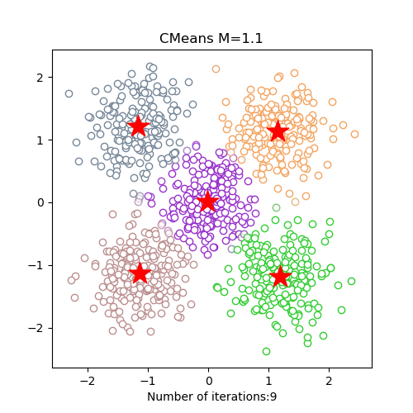
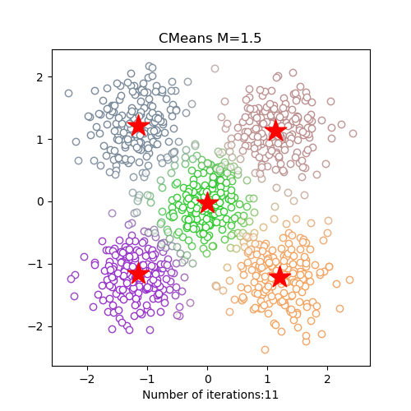
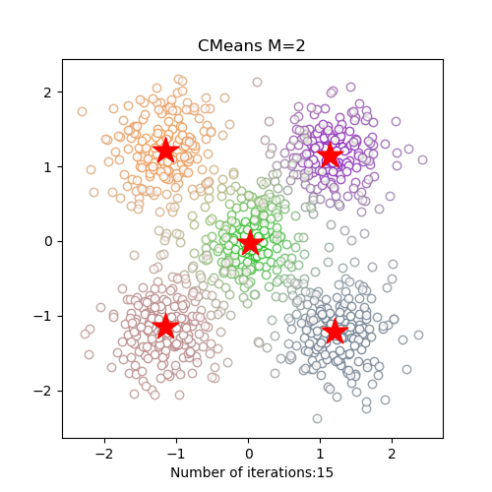
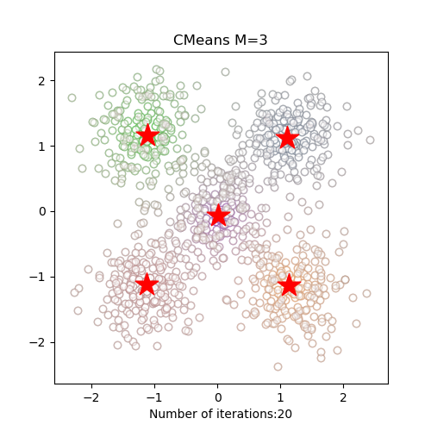
Exercise 4-1
The effects of m by the Fuzzy C-Means
M = 1.1
M = 1.5
M = 2
M = 3

Slide 6
Exercise 4-1
The effects of m by the Fuzzy C-Means
Conclusion:
As m increases, the boundaries between different clusters become more and more blurred
As m increases, the number of iterations increases, and the convergence is slower
When m is close to 1, the effect of the algorithm is similar to it

Slide 7
Exercise 4-2
Compare the Fuzzy C-Means and the K-Means
Initialization:
randomly
Init
Use
to compute the initial centers
Test data set:
Five clusters
Location of centers:
(-1.15, -1.15), (-1.15, 1.15),
(2.5, 2.5), (1.15, -1.15), (1.15, 1.15)
Cluster variance
0.6, 0.6, 0.05, 0.6, 0.6
End condition:
error, error =0.1
C-Means
K-Means
The changed position distance of centers is less than 0.1

Slide 8
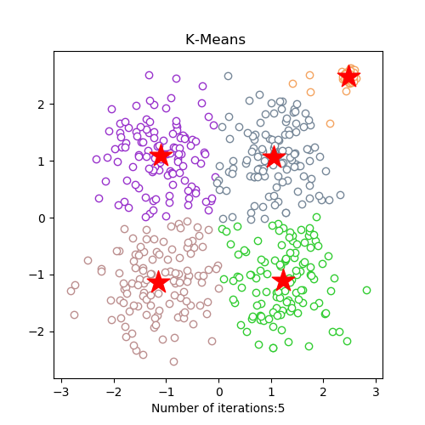
Exercise 4-2
Compare the Fuzzy C-Means and the K-Means
K-Means

Slide 9
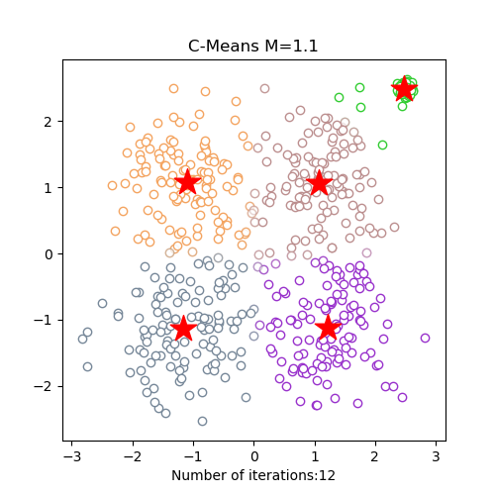
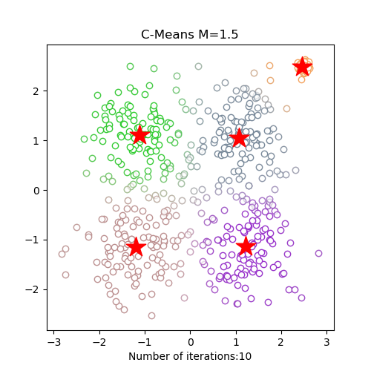
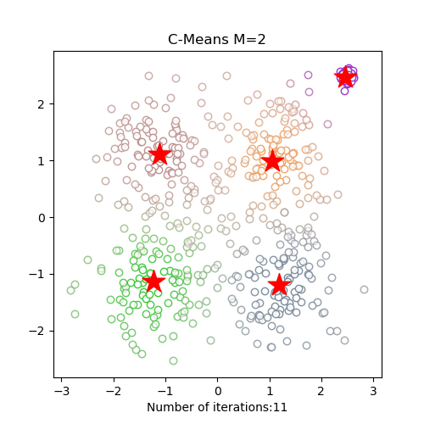
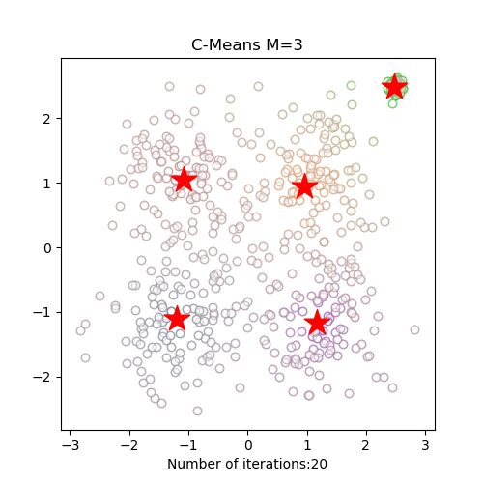
Exercise 4-2
Compare the Fuzzy C-Means and the K-Means
C-Means
M = 1.1
M = 1.5
M = 2
M = 3

Slide 10
Exercise 4-2
Compare the Fuzzy C-Means and the K-Means
Conclusion:
K-Means: Each site is related to only one cluster center
C-Means: Each site is related to all centers

Slide 11
Thanks!
Please contact me with email
if you have any problem
ZhicongSun
Computer Science and Engineering
12032471@mail.sustech.edu.cn
Github: RadarSun
2020.10.29

